Slide 1
Wireless network and ioT security
Lecture 9: Wired Equivalent Privacy (WEP)
Instructor: Kui Ren

Slide 2
Wi-Fi
Wi-Fi is a wireless networking technology used across the globe.
Wi-Fi refers to any system that uses the 802.11 standard, which was developed by the Institute of Electrical and Electronics Engineers (IEEE) and released in 1997.
The term Wi-Fi, which is alternatively spelled WiFi, Wi-fi, Wifi, or wifi, was pushed by the Wi-Fi Alliance , a trade group that pioneered commercialization of the technology.

Slide 3
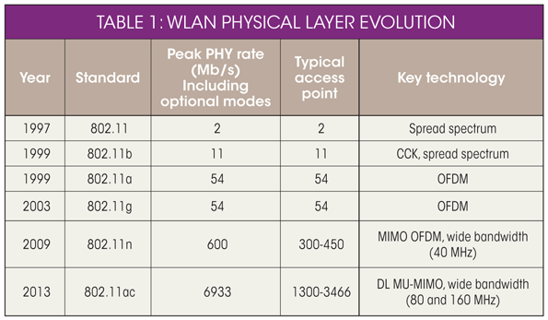
802.11
802.11 is a set of standards for wireless local area network (WLAN) computer communication, developed by the IEEE LAN/MAN Standards Committee (IEEE 802) in the 5 GHz and 2.4 GHz public spectrum bands.

Slide 4
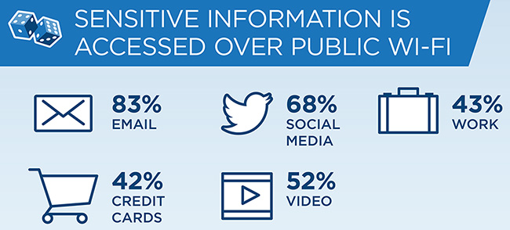
Sensitive Information over Wi-Fi

Slide 5
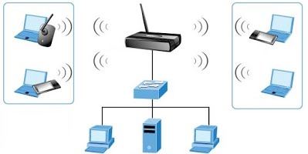
Why security is more of a concern in wireless?
No inherent physical protection
Physical connections between devices are replaced by logical associations 
Sending and receiving messages do not need physical access to the network infrastructure (cables, hubs, routers, etc.)

Slide 6

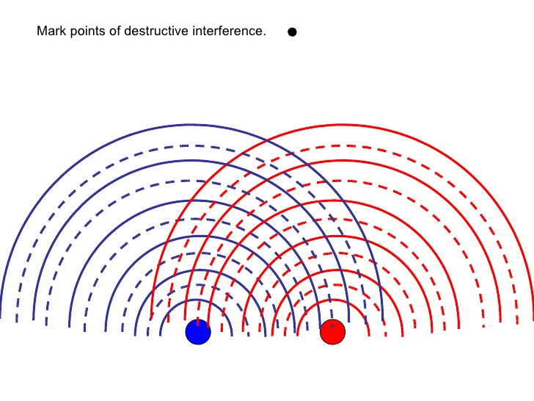
Why security is more of a concern in wireless?
Broadcast communications 
Wireless usually means radio, which has a broadcast nature
Transmissions can be overheard by anyone in range – anyone can generate transmissions,
which will be received by other devices in range
which will interfere with other nearby transmissions and may prevent their correct reception (jamming)

Slide 7

Why security is more of a concern in wireless?
Eavesdropping is easy
Injecting bogus messages into the network is easy
Replaying previously recorded messages is easy
Illegitimate access to the network and its services is easy
Denial of service is easily achieved by jamming

Slide 8

Threats
Wireless technology doesn’t remove any old security issue
Eavesdropping
Man-in-the-middle attacks
Denial of Service

Slide 9

Eavesdropping
Easy to perform, most impossible to detect
By default , everything is transmitted in clear text
Username, passwords, content...
No security offered by the transmission medium
Different tools available on the internet
Network sniffers, protocol analyzers
Password collectors
With the right equipment, it’s possible to eavesdrop traffic from few kilometers away

Slide 10
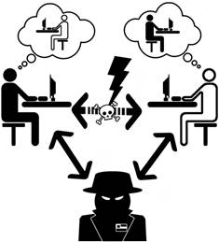
Man In The Middle Attack
Attacker spoofs a disassociate message from the victim
The victim starts to look for a new AP, and the attacker advertises his own AP on a different channel, using the real AP’s MAC address
The attacker connects to the real AP using victim’s MAC address

Slide 11
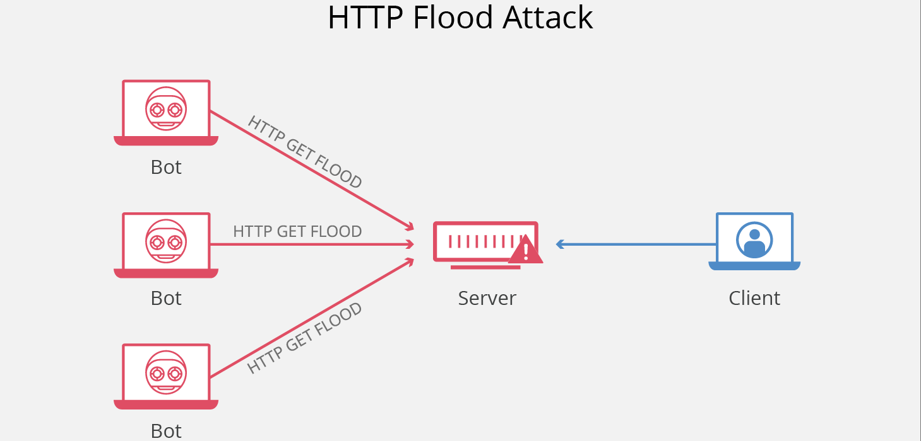
Denial of Service
Attack on transmission regency used
Frequency jamming
Not very technical, but works
Attack on MAC layer
Spoofed disassociation messages
Can target on specific user
Attacks on higher layer protocol (TCP/IP protocol)
SYN Flooding

Slide 12
Wireless Communication Security Requirements
Confidentiality
Authenticity
Replay detection
Integrity
Access control
Protection against jamming

Slide 13

Wi-Fi Security Protocols
Wired Equivalent Privacy (WEP)
Wi-Fi Protected Access (WPA)
Wi-Fi Protected Access II (WPA2)

Slide 14

So what is WEP?
WEP is Wired Equivalent Privacy
Link-layer encryption
Defined in the IEEE 802.11 standard
Goals of WEP
Confidentiality
Access control
Data integrity
Yet, WEP failed to achieve any of the above goals

Slide 15
WEP Flavors
Uses RC4 (stream cipher) for encryption
A compromise of hardware costs, speed, and security
Originally (1999) 64 bit (40 +24):
40 bit key
24 bit Initialization Vector (IV)
128 bit (104 + 14):
104 bit (13 ASCII characters, 26 Hex-Characters) key. 104 = 13*8.
24 bit Initialization Vector (IV)
256 bit:
232 bit key
Available, but not common

Slide 16
WEP Encryption: Players
Message: What you’re encrypting
CRC: To verify the integrity of the message
Plaintext: The message + CRC
Initialization vector (IV): A 24-bit number which plays two roles that we’ll meet in a moment
Key: A 40 or 104-bit number which is used to build the keystream
Keystream: What is used to encrypt the plaintext
Ciphertext: What we end up post-encryption
Message
CRC
IV
Key
Keystream
Ciphertext

Slide 17
WEP Encryption: Step by Step
Message
CRC
Step 1: Compute CRC for the message
CRC-32 polynomial is used

Slide 18
WEP Encryption: Step by Step
Keystream
IV
Key
Step 2: Compute the keystream
IV is concatenated with the key
RC4 encryption algorithm is used on the 64 or 128 bit concatenation

Slide 19
WEP Encryption: Step by Step
Message
CRC
IV
Ciphertext
Keystream
Step 3: Encrypt the plaintext
The plaintext is XORed with the keystream to form the ciphertext
The IV is prepended to the ciphertext

Slide 20
WEP Decryption: Step by Step
IV
Ciphertext
Keystream
Key
Step 1: Build the keystream
Extract the IV from the incoming frame
Prepend the IV to the key
Use RC4 to build the keystream

Slide 21
WEP Decryption: Step by Step
Ciphertext
Message
CRC
Keystream
Step 2: Decrypt the plaintext and verify
XOR the keystream with the ciphertext
Verify the extracted message with the CRC

Slide 22
Major Problems with WEP
Borisov, et al. [1] :
Keystream (IV) reuse
Key management/distribution
Weak message authentication (ICV)
Arbaugh, et al. [2]:
Shared key authentication
Can authenticate with AP without knowing the WEP key
But still don’t know the WEP key, i.e. cannot access the network further
[1] Borisov, Nikita, Ian Goldberg, and David Wagner. "Intercepting mobile communications: the insecurity of 802.11." Proceedings of the 7th annual international conference on Mobile computing and networking. ACM, 2001.
[2] Arbaugh, W. A., Shankar, N., Wan, Y. J., & Zhang, K. (2002). Your 80211 wireless network has no clothes. IEEE Wireless Communications, 9(6), 44-51.

Slide 23
Keystreams
The WEP seed is feed into PRNG to generate a keystream
WEP seed = 24-bit IV + fixed key
Then, the keystream is XOR’ed with the plaintext and checksum to produce the ciphertext.
Whenever the same IV is used with the same master key,
the keystream will be the same as well.
A Stream-Cipher should never use the same key twice!

Slide 24
The Stream-Cipher-Breakdown
E(P1) = P1 xor C [C is the key]
E(P2) = P2 xor C [C is the same key]
Since xor is commutative:
E(P1) xor E(P2) = P1 xor C xor P2 xor C
= P1 xor P2 xor C xor C
= P1 xor P2

Slide 25
Keystream Reuse/Collision
Master keys are unlikely to be changed due to key management issues (more on this later…)
24 bits of IV are not sufficient to avoid collisions
Assuming 1500-byte packets at 11 Mbps, 2^24 possible IVs will be exhausted in about 5 hours
If IVs are assigned randomly, collisions can be expected (50% probability) after 5000 packets (Birthday paradox).
If IVs are assigned sequentially, collisions are inevitable if cards are re-initialized (e.g., always start from zero)

Slide 26
Initialization vector (IV)
It’s carried in plaintext in the “encrypted” message!
It’s only 24 bits!
There are no restrictions on IV reuse!
The IV forms a significant portion of the “seed” for the RC4 algorithm!
It was discovered that it is easy to decrypt RC4 ciphertext if part of the key is known.

Slide 27
Weak IVs and Weak Keys in RC4
It has been known for a while that RC4 has weak keys
Weak keys are more susceptible to showing the relationship between plaintext and ciphertext
Weak IVs correspond to weak Keys.
Weak IVs have the following patterns:
First byte: range from 3 to 7
Second byte: 255
Third byte: anything
There are approx. 9000 weak IVs out of the 40 bit WEP secret keys. It is about 5% of total number IVs.

Slide 28
Weak Message Integrity (ICV)
The ICV is generated from a cyclic redundancy check (CRC-32)
Only a simple arithmetic computation.
Can be done easily by anyone.
Not cryptographically secure.
Easy for an attacker to change a packet and then change ICV to get response from AP.
E.g., replay attacks or injection attacks

Slide 29
Key Management
WEP does NOT include any key management protocols!
Master keys could be one of four globally shared keys
Key must be updated manually
Often, one key is relied on

Slide 30
WEP (Re)Keying in Practice
Keys are manually distributed
Keys are statically configured
Implications: often infrequently changed and easy to remember!
Key values can be directly set as hex data
Key generators provided for convenience
ASCII string is converted into keying material
Non-standard but in wide use

Slide 31
User Authentication
Authentication is optional
WEP uses a “Shared Key Authentication” protocol to authenticate stations
Initiator requests shared key authentication
Responder sends initiator random challenge text
Initiator sends responder encrypted challenge text
Responder signals successful completion of protocol
This is supposed to prove that the initiator knows the correct key
However, if a keystream is known, no key is necessary, so anybody can authenticate!

Slide 32
WEP Weakness Summary
IV (key) reuse due to limited IV space
Known plaintext attack
Lots of known plaintext in IP, ICMP, ARP, and etc.
Partial known plaintext attack
e.g., the IP header
Possible to recover some portion of the keystream
Can extend partially recovered keystream to the entire keystream via repeated probing/trying
Weak Integrity check (ICV)
Lack of IV replay protection (ARP replay attacks)
Possible to flip bits in real time, which is enabled by linearity of CRC32 (weak integrity check)

Slide 33
WEP Weakness Summary (Cont’d)
No key management or exchange framework defined
Loose authentication
Beacon messages are not authenticated
Enables station to roam to a rogue AP
Disassociate (also De-auth), re-associate messages not authenticated
Enables DoS attacks

Slide 34
Common Attacks on WEP
The Brute Force / Dictionary Attack
The FMS Attack
The Chopchop Attack
The Fragmentation Attack

Slide 35
Common Attacks: The Brute Force / Dictionary Attack
“Power” of the WEP relies in the difficulty of discovery of the secret key through a brute-force attack
“Dictionary attack” uses dictionary of keys, not all possible keys
Such attack requires less then a month for all keys

Slide 36
The Brute Force / Dictionary Attack: Steps
Capture 2 WEP encrypted packets
Try to decrypt it using the captured IV and a potential key
Verify decrypted ICV (the CRC)
Verify the key on the 2nd packet (optional)

Slide 37
Common Attacks: The FMS Attack
2001 – Fluhrer, Martin and Shamir found a class of RC4 keys called “weak keys”
If the first 2 bytes of enough key stream are known -> The RC4 key is discovered
The first 8 bytes of WEP packet is a known SNAP-SAP header
AirSnort implements this attack
Recovers key after 20,000 packets = 11 seconds

Slide 38
Common Attacks: The Chopchop Attack
Does not recover the key, it just reveals the message
Exploits an ICV vulnerability
Steps:
Capture one packet
Truncate the last byte and try to guess one “value” for plaintext
Correct the checksum and send packet to AP
If guess is correct the AP will reply
Repeat until all bytes are decrypted

Slide 39
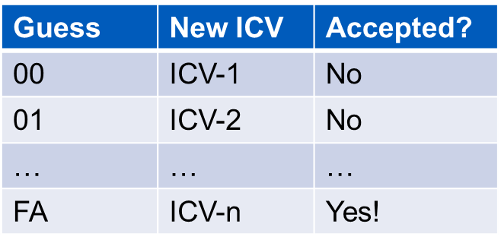
KoreK Chopchop Attack Illustrated
Encrypted Data
ENC. ICV
FA
Encrypted Data
?
Guess the value of the deleted byte and calculate new ICV

Slide 40
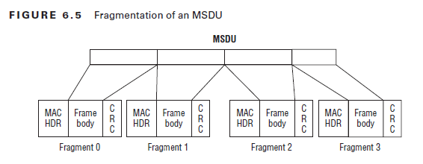
Common Attacks: The Fragmentation Attack
Fragmentation means chopping a packet into smaller packets
Increases the traffic but improves performance in the presence of noise
802.11 and IP protocol allow fragmentation
802.11 allows for at most 16 fragments
This feature can be used for breaking WEP!

Slide 41
Fragmentation Attacks, Basics
During fragmentation, WEP encryption is performed independently on each individual fragment using the same IV.
Possible to send multiple fragments (16) using the same key stream
You know more about the plaintext than you think you know.
Almost all encrypted data packets have a LLC/SNAP header, 8 bytes
XOR gives 8 bytes of the key stream
At this point, arbitrary data of (8 − 4) · 16 = 64 bytes (4 byte CRC tag) may be sent
Can be either
IP or ARP
AA
AA
03
00
00
00
08
??
DSAP
SSAP
CTRL
ORG Code
Ether type

Slide 42
Protecting WEP
Increase the number of bytes used for encryption (“protects” against FMS attack)
Remove the weak IV - keystream re-use vulnerabilities
Prevent key re-use
Extensible Authentication Protocol (EAP) – change often the WEP-key
Deploy Intrusion Detection Systems (IDS) to protect against injected traffic
Companies sell hardware using modified versions of the WEP protocol claiming to be secure

Slide 43
Conclusions
WEP has a long history of vulnerabilities and “fixes”
WEP is a good example of how attacks evolve and mature over time
Attacks that a few years ago took days, now take minutes if the right tools are used
2005 WEP is officially declared deprecated by IEEE 802.11 committee
2008 WEP used by 30% of users in a US university
Today – too many old networks, some using WEP
WEP must be abandoned once and for all, rather than patch it yet again !!!

